Slide 1
Chapter 5
Reducibility

Slide 2

Reduction
What is reduction?
Is a powerful method which can be used to prove that a language A has some property based on the fact that another language B has the same property.
Reduction method idea
Consider two problems A and B, if we can use the solution to B to construct a solution to A, we say that A can be reduced to B (or A is reducible to B)

Slide 3



A Simple Reduction
I can’t lift a car
Can I lift a truck?
No!... Because that would mean I can lift the car
Given
New Question
Answer

Slide 4
Simple Reductions
Examples.
The problem of traveling from SLC to London
The problem of measuring the area of a rectangle
Can be reduced to the problem of buying a plane ticket between the two cites
Can be reduced to the problem of measuring its length and width

Slide 5
Relating Known/Unknown Answers
A reduction is a way of providing an answer to a new (unknown) problem, based on the answer given by a known problem
Unknown “turns” into Known
Unknown
Known
Known determines the answer of Unknown

Slide 6
Relating Reduction and Decidability
If we can reduce an undecidable problem HARD to HARDER, then we know that we cannot decide HARDER
Undecidable
Undecidable
Hard reduces to Harder
Hard
Harder
Decider for Harder decides Hard as well

Slide 7
More Reduction Examples
The problem of determining if a language is decidable. Consider two languages A & B and a solution is a decider. In this case if A can be reduced to B:
If B is decidable, then A is decidable
If A is undecidable, then B is undecidable
The problem of determining if a language is Turing-recognizable. Consider A & B as two languages and a solution is a TM. In this case if A can be reduced to B
If B is Turing-recognizable, then A is Turing-recognizable
If A is Turing-unrecognizable, then B is Turing-unrecognizable

Slide 8
Solving Problems Using Reduction
Recall
Given A_{TM} = { <M, w> | M is a TM and M accepts w }, i.e., does M accept input w?
A_{TM} is undecidable, based on the proof covered in Chapter 4 (Theorem 4.11)
Is the problem of determining whether a TM halts on a given input decidable, i.e., HALT_{TM} = { < M, w >| M is a TM and M halts on input w }
Theorem 5.1. HALT_{TM} is undecidable.
Proof. (By reduction from A_{TM} to HALT_{TM})
Let’s assume that a TM R decides HALT_{TM} and let’s construct a TM S to decide A_{TM} :
S = “On input <M, w>, the encoding of a TM M and a string w
Run TM R on <M, w>
If R rejects, reject
If R accepts, simulate M on w until it halts
If M has accepted, accept; if M has rejected, reject.”
Clearly, if R decides HALT_{TM}, then S decides A_{TM} , which is a contradiction, since A_{TM} is undecidable . Consequently, HALT_{TM} is undecidable.

Slide 9
Solving Problems Using Reduction
Is the problem of determining whether a TM accepts empty set decidable, i.e., E_{TM} = { < M >| M is a TM and L(M) = φ }?
Theorem 5.2. E_{TM} is undecidable.
Proof. Assume that E_{TM} is decidable & show that A_{TM} is decidable (reduce A_{TM} to E_{TM}). Let R be a TM that decides E_{TM} . We use R to construct TM S that decides A_{TM}. Since if R rejects < M >, L(M) ≠ φ, but we don’t know whether M accepts w. Thus, we run R on a modified < M >, which rejects all strings, except w & work on w, as usual. (Recall that A_{TM} = { <M, w> | M is a TM and M accepts w }.)
Let’s assume that a TM R decides E_{TM} and let’s construct a TM S to decide A_{TM} :
S = “On input <M, w>, the encoding of a TM M and a string w:
Construct the TM M₁, where M₁ = “on input x:
If x ≠ w, reject.
If x = w, run TM M on input w & accept if M does.”
Run R on input < M₁ >
If R accepts, reject; if R rejects, accept.”
Clearly, if R decides E_{TM}, then S decides A_{TM} , which is a contradiction, since A_{TM} is undecidable . Consequently, E_{TM} is undecidable.

Slide 10
Solving Problems Using Reduction
Is the problem of determining whether a TM accepts empty set decidable, i.e., E_{TM} = { < M >| M is a TM and L(M) = φ }?
Hierarchical Structure of the Simulated TMs:
S
R
M₁
M

Slide 11
Solving Problems Using Reduction
Is the problem of determining whether a given TM recognizes a regular language?
REGULAR_{TM} = { <M> | M is a TM and L(M) is a regular language }
Theorem 5.3. REGULAR_{TM} is undecidable.
Proof. Let REGULAR_{TM} be decidable & show that A_{TM} is decidable (reduction from A_{TM} to REGULAR_{TM}). Let TM R decide REGULAR_{TM} & use R to construct TM S that decides A_{TM}. We design M₂ to recognize non-regular languages if M rejects w & recognize the regular language Σ* if M accepts w.
Let’s assume that a TM R decides REGULAR_{TM} and let’s construct a TM S to decide A_{TM} :
S = “On input < M, w >, where M is a TM and w is a string:
Construct the following TM M₂
M₂ = “On input x:
If x has the form 0^{n}1^{n}, accept
If x does not have the form 0^{n}1^{n}, run M on input w & accept if M accepts w”
Run R on input <M₂>
If R accepts, accept; if R rejects, reject.”
Clearly, if R decides REGULAR_{TM}, then S decides A_{TM} , which is a contradiction, since A_{TM} is undecidable by Theorem 4.11. Consequently, REGULAR_{TM} is undecidable.

Slide 12
Solving Problems Using Reduction
Is the problem of determining whether two TMs accept the same language decidable, i.e., EQ_{TM} = { < M₁, M₂ >| M₁ & M₂ are TMs and L(M₁) = L(M₂) }?
Theorem 5.4. EQ_{TM} is undecidable.
Proof. Let EQ_{TM} be decidable & show that E_{TM} is decidable (reduction from E_{TM} to EQ_{TM}). Note that E_{TM} is a special case of EQ_{TM}, i.e., if one of the two languages of a TM is φ, we end up with the problem of determining whether the language of another TM is empty, i.e., the E_{TM} problem.
Let’s assume that a TM R decides EQ_{TM} and let’s construct a TM S to decide E_{TM} :
S = “On input < M >, where M is a TM:
Run R on input < M, M₁ >, where M₁ is a TM rejects all inputs
If R accepts, accept; if R rejects, reject.”
Clearly, if R decides EQ_{TM}, then S decides E_{TM} , which is a contradiction, since E_{TM} is undecidable by Theorem 5.2 . Consequently, EQ_{TM} is undecidable.

Slide 13
Theorem 5.1. HALT_{TM} = { <M, w> | M is a TM and M halts on input w } is undecidable.
We use the undecidability of A_{TM} to prove the undecidability of the halting problem by
reducing A_{TM} to HALT_{TM}, i.e.,
“If A_{TM} is undecidable, then HALT_{TM} is undecidable, i.e., A_{TM} ⇒ HALT_{TM}.”
Proof. (By contrapositive rule) If HALT_{TM} is decidable, then A_{TM} is decidable.
Let’s assume that a TM R decides HALT_{TM}, and let’s construct a TM S to decide A_{TM}:
Rd
S
on input w
M halts on input w
Accept
Accept
Accept
M
Reject
<M, w>
R
Reject
on input w
M does not halt on w
Reject

Slide 14
Theorem 5.2. E_{TM} = { <M> | M is a TM and L(M) = φ } is undecidable.
We use the undecidability of A_{TM} to prove the undecidability of the emptiness problem
by reducing A_{TM} to E_{TM}, i.e.,
“If A_{TM} is undecidable, then E_{TM} is undecidable, i.e., A_{TM} ⇒ E_{TM}.”
Proof. (By contrapositive rule) If E_{TM} is decidable, then A_{TM} is decidable.
Let’s assume that a TM R decides E_{TM}, and let’s construct a TM S to decide A_{TM}:
Rd
S
x ≠ w
Reject
on input w
Reject
Reject
<M, w>
M₁
Accept
M
Accept
x = w
on input w
Reject
Accept
R

Slide 15
Theorem 5.3. REGULAR_{TM} = { <M> | M is a TM and L(M) is a regular language } is undecidable.
We use the undecidability of A_{TM} to prove the undecidability of the regular language problem by reducing A_{TM} to REGULAR_{TM}, i.e.,
“If A_{TM} is undecidable, then REGULAR_{TM} is undecidable, i.e., A_{TM} ⇒ REGULAR_{TM}.”
Proof. (By contrapositive rule) If REGULAR_{TM} is decidable, then A_{TM} is decidable.
Let’s assume that a TM R decides REGULAR_{TM}, and let’s construct a TM S to decide A_{TM}:
Rd
S
x ∈ 0^{n}1^{n}
Accept
<M, w>
<M₂, w>
M₂
on input w
Accept
Accept
M
Accept
x ∉ 0^{n}1^{n}
on input w
Reject
Reject
Reject
R

Slide 16
Theorem 5.4. EQ_{TM} = { <M₁, M₂> | M₁ & M₂ are TMs and L(M₁) = L(M₂) } is undecidable.
We use the undecidability of E_{TM} to prove the undecidability of the equality problem
by reducing E_{TM} to EQ_{TM}, i.e.,
“If E_{TM} is undecidable, then EQ_{TM} is undecidable, i.e., E_{TM} ⇒ EQ_{TM}.”
Proof. (By contrapositive rule) If EQ_{TM} is decidable, then E_{TM} is decidable.
Let’s assume that a TM R decides EQ_{TM}, and let’s construct a TM S to decide E_{TM}:
Rd
S
L(M) = L(M₁)
<M>
<M, M₁>
R
Accept
Accept
where L(M₁) = φ
L(M) ≠ L(M₁)
Reject
Reject

Slide 17
Solving Problems Using Reduction
Let TOTAL = { < M > | M is a TM that halts on all inputs }
How to prove TOTAL is undecidable?
Reduce HALT_{TM} = { <M, w> | M is a TM & M halts on input w } to TOTAL
Show how a decider for TOTAL could be used to build a decider for HALT_{TM}
Conclude such a decider can’t exist
This is a key step in most reductions:
Build a TM that has a property of the new problem (e.g., TOTAL) based on whether other TM has a property of the old problem (e.g., HALT).
Deciding whether this TM has the new property decides whether some other TM has the old property
Assume TOTAL is decidable.
Let T be a decider for TOTAL
H = “On input <M, w> :
Construct the TM M' = “On input x:
Ignore x.
Run M on w.
If M accepts w, accept.
If M rejects w, reject.”
Run T on <M‘> .
If T accepts, accept.
If T rejects, reject.”
Assume TOTAL is decidable
Build a TM H that accepts <M, w> and constructs a TM M’ that is a decider if M halts on w
Using the decider for TOTAL, H checks whether M’ is a decider:
If M’ is a decider, then M halts on w
If M’ is not a decider, then M does not halt on w
Conclude that if TOTAL is decidable, then HALT is decidable
But HALT is undecidable, so the initial assumption was wrong and TOTAL is undecidable.

Slide 18
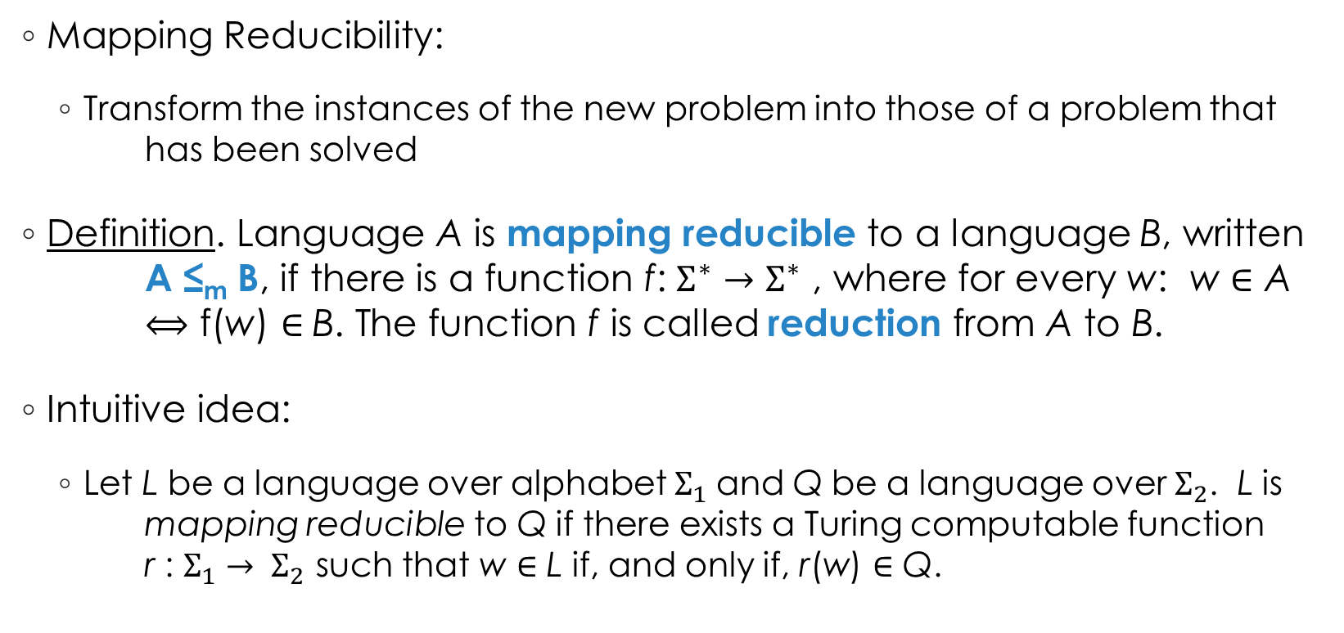
Mapping Reducibility
Mapping Reducibility:
Transform the instances of the new problem into those of a problem that has been solved
Definition. Language A is mapping reducible to a language B, written A ≤_{m} B, if there is a function f: $Σ^{∗}→Σ^{∗}$ , where for every w: w $∈$ A $⟺$ f(w) $∈$B. The function f is called reduction from A to B.
Intuitive idea:
Let L be a language over alphabet $Σ_{1}$and Q be a language over $Σ_{2}$. L is mapping reducible to Q if there exists a Turing computable function r : $Σ_{1}$ $→ Σ_{2}$ such that w $∈$ L if, and only if, r(w) $∈$ Q.

Slide 19
Mapping Reducibility
Example. Let A = { x | x is an even integer } and B = { x | x is an odd integer }. Then function f(x) = x + 1 is a mapping reduction from A to B, i.e., A ≤_{m} B, since
x ∈ A ⇔ x is even ⇔ x + 1 is odd ⇔ x + 1 ∈ B ⇔ f(x) ∈ B
Given below is the mapping reduction function f such that x is encoded as a sequence of 1’s, e.g., x = 3 is encoded as B111B
B → B, R
1 → 1, R
>
q
0
q
q
1
2
1 → 1, R
B → 1, L
B → 1, L
1 → 1, L
q
q
3
B → B, S
4

Slide 20
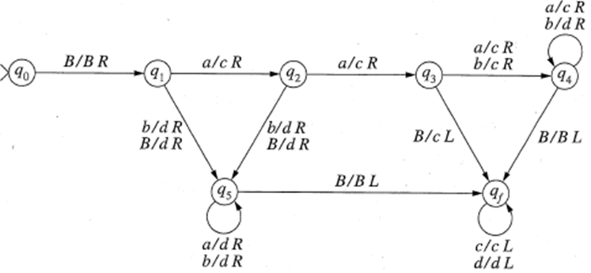
Polynomial-Time Reduction: Examples
Example. The following TM R performs a polynomial-time reduction of the language L = aa(a ∪ b)* to the language Q = ccc(c ∪ d)*. (Note that X/X R in the diagram stands for X → X, R.)

Slide 21

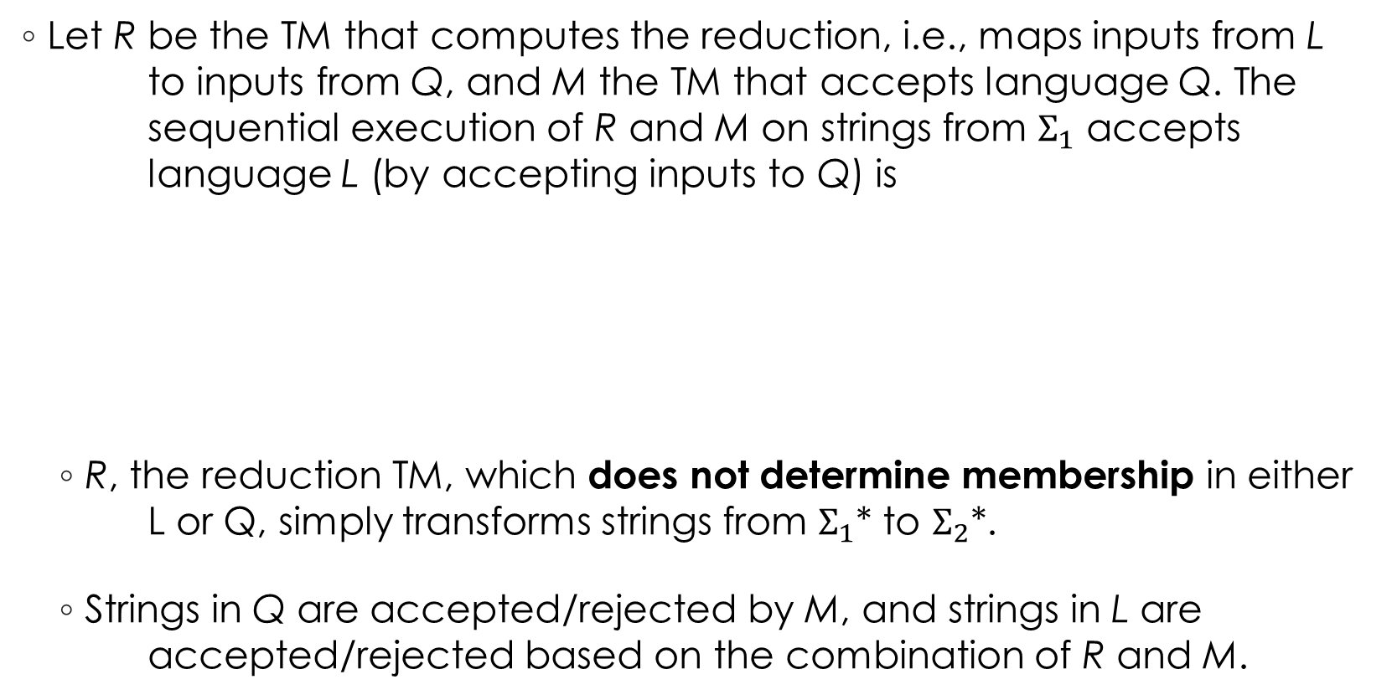

Mapping Reducibility
Let R be the TM that computes the reduction, i.e., maps inputs from L to inputs from Q, and M the TM that accepts language Q. The sequential execution of R and M on strings from $Σ_{1}$ accepts language L (by accepting inputs to Q) is
R, the reduction TM, which does not determine membership in either L or Q, simply transforms strings from $Σ_{1}$* to $Σ_{2}$*.
Strings in Q are accepted/rejected by M, and strings in L are accepted/rejected based on the combination of R and M.
If M says Yes
R
M
Yes
$w (∈Σ_{1}$*)
$r(w) (∈Σ_{2}$*)
No
If M says No

Slide 22
Using Mapping Reducibility
Theorem 5.22: Let A and B be any two languages. If A ≤_{m} B and B is decidable, then A is decidable
Basically, if a language A is reducible to a decidable language B by a function r, then A is also decidable.
Proof:
Corollary 5.24: Let A and B be any two languages. If A ≤_{m} B and A is undecidable, then B is undecidable
Let M be a decider for B and f be a reduction from A to B.
N = On input w
Compute f(w)
Run M on input f(w) and output whatever M outputs.
Clearly, if w ∈ A, then f(w) ∈ B because f is a reduction from A to B. Thus, M accepts f(w) whenever w ∈ A. Therefore, N works as expected.

Slide 23
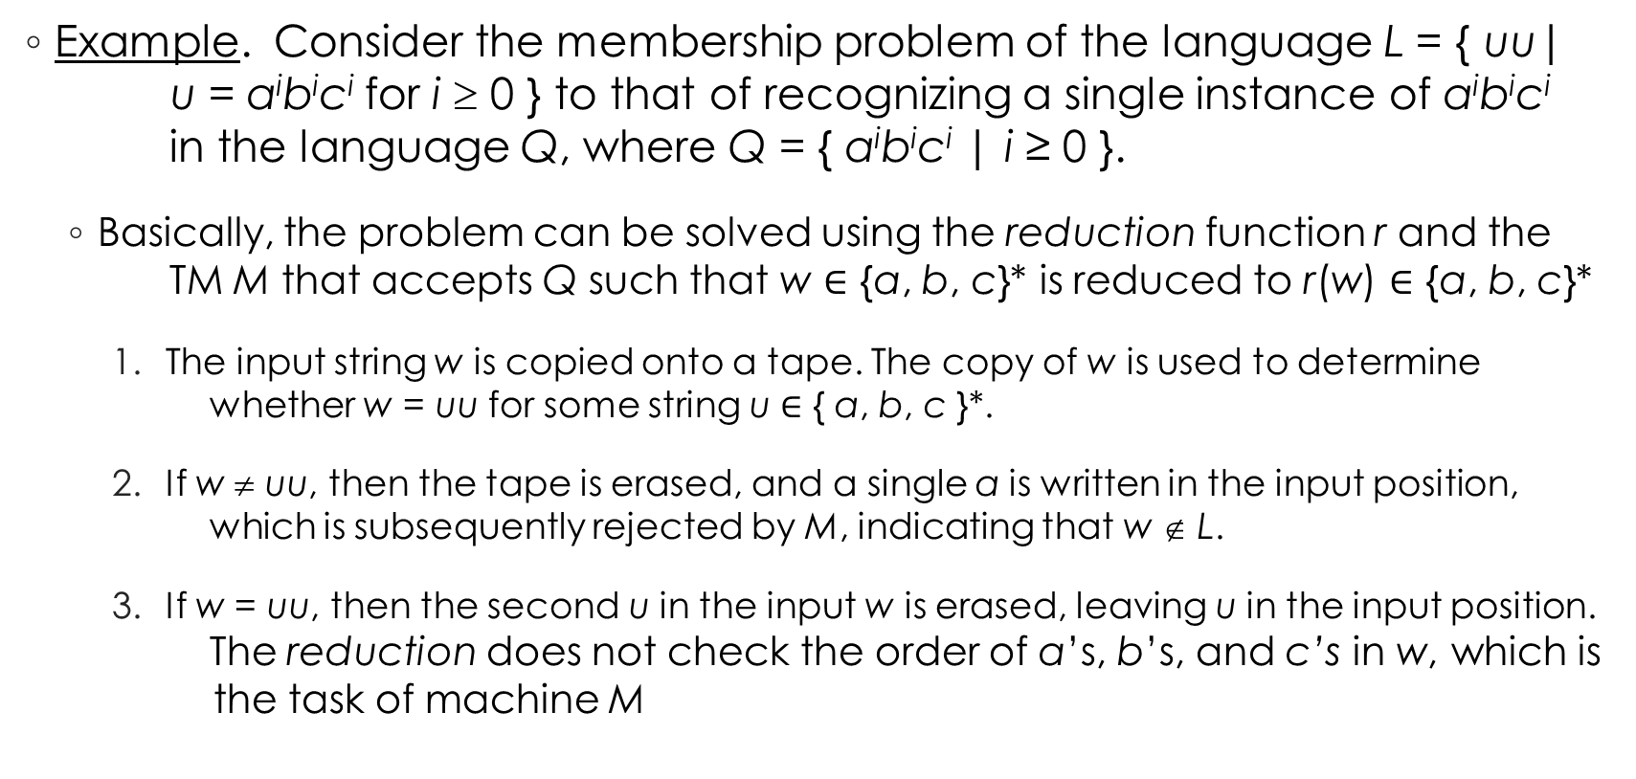
Using Mapping Reducibility
Example. Consider the membership problem of the language L = { uu| u = a^{i}b^{i}c^{i} for i ≥ 0 } to that of recognizing a single instance of a^{i}b^{i}c^{i} in the language Q, where Q = { a^{i}b^{i}c^{i} | i ≥ 0 }.
Basically, the problem can be solved using the reduction function r and the TM M that accepts Q such that w $∈$ {a, b, c}* is reduced to r(w) $∈$ {a, b, c}*
The input string w is copied onto a tape. The copy of w is used to determine whether w = uu for some string u $∈$ { a, b, c }*.
If w ≠ uu, then the tape is erased, and a single a is written in the input position, which is subsequently rejected by M, indicating that w ∉ L.
If w = uu, then the second u in the input w is erased, leaving u in the input position. The reduction does not check the order of a’s, b’s, and c’s in w, which is the task of machine M
Reduction Input Condition
L w ∈ {a, b, c}* w ∈ L
↓ ↓ r if and only if
Q r(w) ∈ {a, b, c}* r(w) ∈ Q

Slide 24






Using Mapping Reducibility
Remember that R only “reduces” the string from the alphabet of L to the alphabet of Q. We use M to determine acceptance/rejection of an input string r(w) and use R and M together to determine the acceptance/rejection of w
$$abcabc$$
Convert the input w ∈ {a, b, c}* into r(w) ∈ {a, b, c}* such that if w ∈ L, then r(w) ∈ Q
$$abc$$
M accepts
M
Yes
$$acbbc$$
$$a$$
$$abcc$$
$$a$$
No
M rejects
R

Slide 25
Types of Problems Related to a TM
Verify case by case
Problems about the behavior of a TM M:
whether M runs for more than 10 steps on the empty string - decidable
whether M writes symbol a on the tape at some point - undecidable
Problems about the structure of a TM M:
whether M has more than 10 states - decidable
whether M has at least 5 transitions - decidable
Problems about the language of a TM M:
whether L(M) contains the empty string – nontrivial, therefore undecidable
whether L(M) is regular – nontrivial, therefore undecidable
Create a decider
Non-trivial property => Undecidable

Slide 26

Common problems...
Identifying Decidable/Undecidable is the 1st step…
Chances are you’ll need to use reductions/construction of a decider to prove your answers ;)
Does M halts on all inputs?
Does M not accept <M>?
Does M accept w?
Is L(M) regular?
M has more than 5 states
UNDECIDABLE!
UNDECIDABLE!
UNDECIDABLE!
UNDECIDABLE!
DECIDABLE!

